Slide 1
AI Enrichment in Azure Cognitive AI Search
Will Velida – Lead Software Engineer
Azenix
November 2023
Notes:
- Hi everyone, my name is Will Velida – I’m a Lead Software Engineer for Azenix working out of Melbourne (make comment on Sydney weather)
- Today, I’m going to be talking about AI enrichment in Azure AI Search! (oooooo). –The name was Azure Cognitive Search, but it got changed this morning :D
- Now there’s a lot to Azure Cognitive Search, so I’ll cover what it is briefly, then I’ll dive into the specifics of how AI enrichment works, followed by a demo.

Slide 2
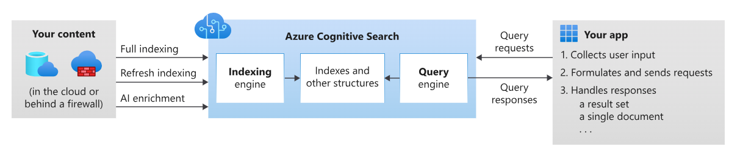
What’s Azure AI Search?
Cloud search service that gives developers tools for build rich search experiences
Full text and vector search over indexes
Lexical analysis and AI enrichment for content extraction and transformation
Querying support for vector queries, text search, fuzzy search, autocomplete and more.
Notes:
Let’s start with Cognitive Search.
Cognitive Search is Azure’s cloud search service that gives developers infrastructure, APIs and tools for build search experiences over private content for web, mobile and enterprise applications.
With Cognitive Search, you have the ability to perform full text and vector search over a search index
Rich indexing, with lexical analysis and AI enrichment
Support for vector queries, autocomplete, fuzzy search and more
Essentially, you search service will sit between your un-indexed data and your client applications that make requests to the search index and handles the response.

Slide 3
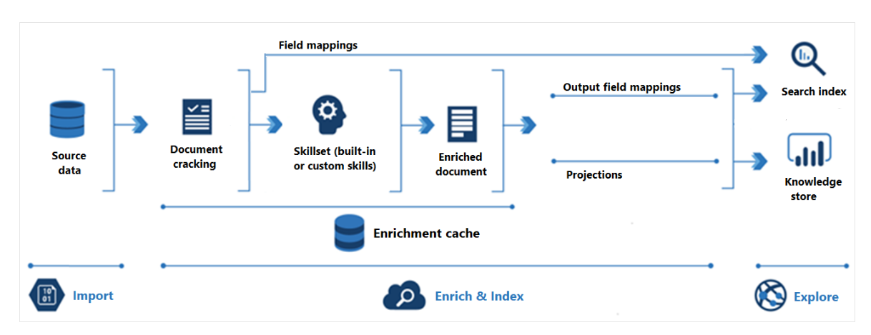
AI Enrichment in Azure AI Search
Applying ML models over content that isn’t full text searchable in its raw form.
Improve the utility of your content in search-related scenarios
Enrichment is an extension of indexers that connect to data in Azure
Contains the indexer, the data source, the index, and the skillset that specifies enrichment steps
Notes:
Lets dive a bit further into AI enrichment.
AI enrichment is the application of ML models over content that isn’t full text searchable in it’s raw form.
Through the enrichment, we create searchable content and structure to our data where non previously existed
We enable AI enrichment through indexers. I’ll talk about this later, but we can of this almost as an ETL process that takes our data, applies some transformation to it through AI, and creates searchable content for us.

Slide 4
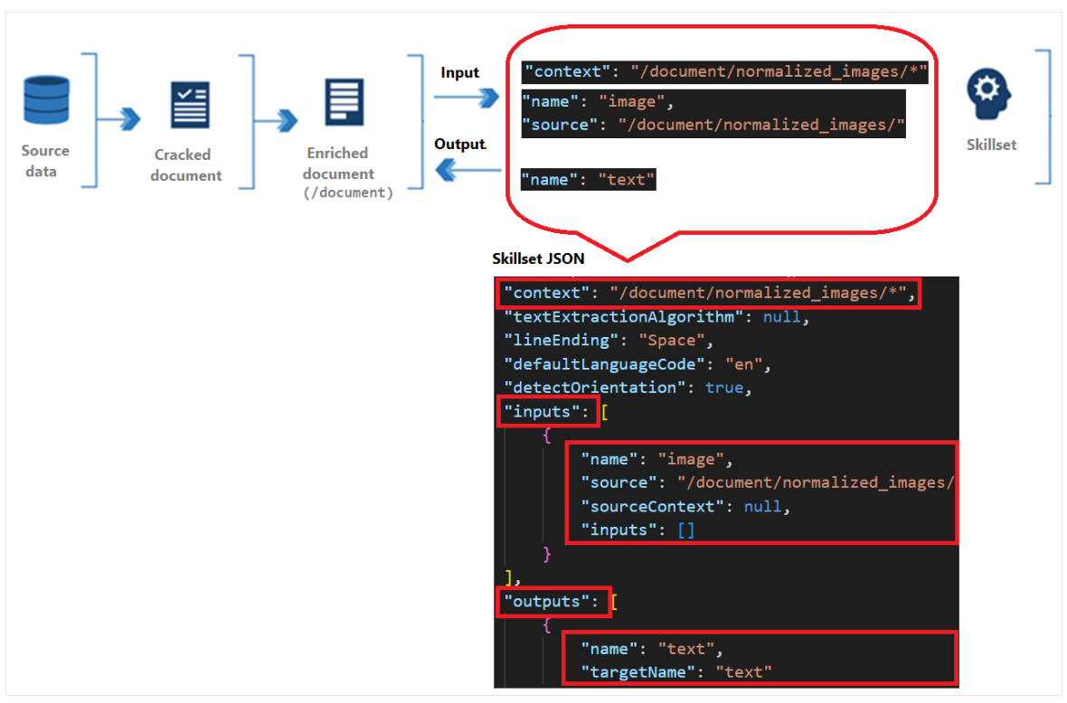
Skillsets
Contains one or more AI “skills” that contain built-in or custom AI models for processing.
An array of one or more skills that perform enrichment.
Can be built-in (Pre-built models) or custom (DIY models) skills.
Produces enriched documents that are consumed during indexing.
Notes:
So where does the AI come into it? The answer to that is skillsets
Skillsets are reusable resources in Cognitive Search that’s attached to an indexer
It contains one or more skills that call either built-in AI or external custom processing over documents retrieved from external data sources.
When we execute skillsets, skills will read from and write to an enriched document,
Initially this will just be the raw content from our data source, but as we execute skills, the enriched document gains structure to which we can search on.

Slide 5
Built-in skills vs Custom Skills
What’s the difference? Which one should you use?
Built-skills
Custom skills
Based on Azure AI Services.
Can use skills ‘built-in’ to AI Search
Can use an external Azure AI resource.
Good for easy setup, but has inconsistent results
Execute external code that’s wrapped in a custom web skill interface.
Doesn’t have to be complex!
Great for using specific custom-built models but requires more management.
Notes:
With skillsets, we can use either built-in skills or custom skills
Built-in skills are based on pre-trained models that are provided by Microsoft. This is handy for when you want to use one of the AI services from Microsoft, but as we worked on it with Bupa, we found that it can produce some inconsistent results!
You can use built in skills that are baked into the Cognitive Search service itself, or you can create a multi-ai resource to offload the processing to that.
You can also use custom skills for AI enrichment.
These are modules that you design, develop and deploy to the web. You can then call the module from within a skillset as a custom skill.
Custom skills are great for when you need to insert transformations that are unique to your content. For example, the MSFT health APIs are specific to the USA, so we can build custom skills that are more relevant to Australian health data.

Slide 6

Indexers in Azure AI Search
Cloud-based crawlers that extracts data and populates your search index
Extracts content from cloud data sources and populates your search index.
‘Pulls’ data from source data into index using field-to-field mappings.
AI enrichment happens during the indexing process.
Can run indexers on demand, or on recurring basis.
The stages of indexing executes the following steps:

Slide 7
Typical AI Enrichment Workflow
Most enrichment workflows look like this…..
Create a data source that you’ll pull data from into your search index
Create a skillset that will specify which skills you’ll use to enrich your data.
Create an index schema that defines a search index.
Create and run the indexer that brings all these components together
Run queries on your enriched data.
Notes:
So a typical AI enrichment workflow would look something like this

Slide 8
Demo time!

Slide 9

That’s great, but what isn’t so great about it?
Real-world considerations/Things that I dislike about Azure AI Search
Built-in skillsets do poorly in high throughput situations.
Extensive AI/ML capabilities need custom models.
Indexers are not background processes.
Azure AI Search is a product designed by data people for developers 🙃

Slide 10
Wrapping up
Indexers pull data from supported cloud sources.
Enrich your indexers with Skillsets to enhance your data with AI capabilities.
Perform search queries over your data.
Can use either built-in skills from Microsoft, or custom skills for your own models.

Slide 11


https://github.com/willvelida/ai-enrichment-azure-cognitive-search

